Slide 1
Data Lake Gen 1 Troubleshooting
(It’s Mostly About Permissions)
whhender - Jan 2020

Slide 2
Today’s Agenda
ADLS Gen 1 Knowledge Basics
ADLS Troubleshooting for the Big Three
Jarvis Basics
Documentation/TSGs
Where to Go for Help – Teams, ICMs, and Meetings
Note: Everything we will cover today is documented in either the ADLS public documentation, the Big Data Wiki (aka.ms/bigdata), or in the Product Team’s TSGs (Trouble Shooting Guides). These are your best resources.

Slide 3
ADLS Gen 1 Knowledge Basics
ADLS Gen 2 is a completely different product and built on top of Blob Storage. ADLS Gen 2 support is covered by the blob store team.
ADLS Cases Mostly Fall Into Three Categories:
Permissions
Accidental Deletion
Performance

Slide 4
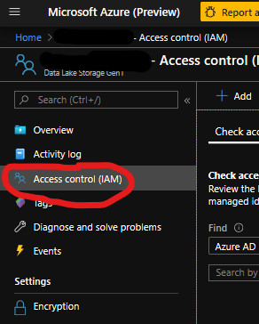
ADLS Gen 1 – Permissions
RBAC (Role-Based Access Control) Permissions
Resource-Level Permissions
Role | Management rights | Data access rights
No RBAC Role Assigned | None | Governed by ACL
Owner | All | All
Reader | Read-Only | Governed by ACL
Contributor | All except Add and Remove Roles | Governed by ACL
User Access Administrator | Add and Remove Roles | Governed by ACL

Slide 5
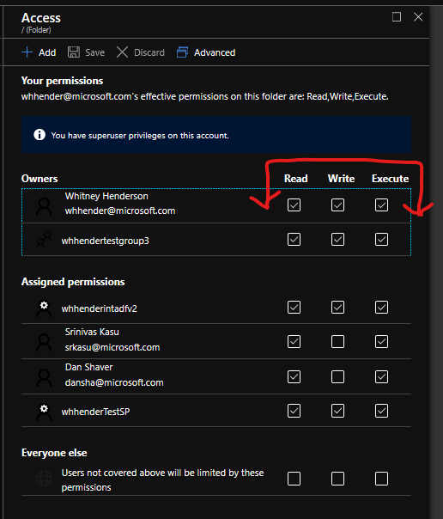
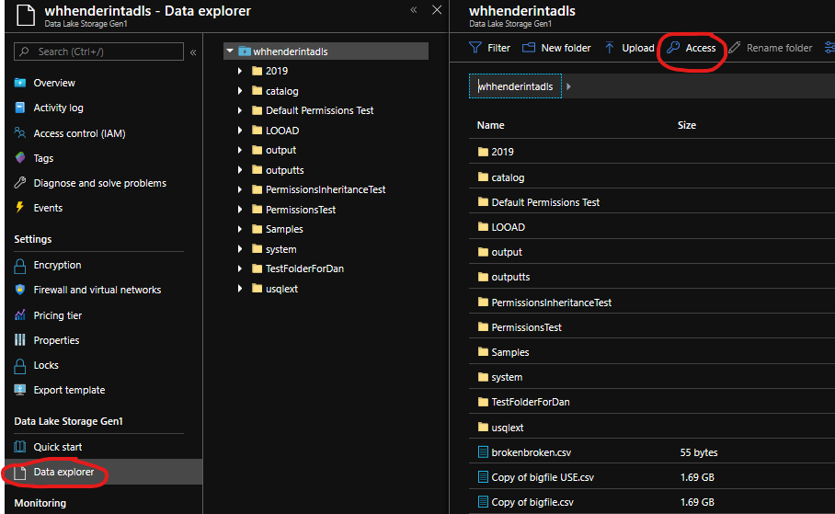
ADLS Gen 1 – Permissions
ACL (Access Control List) Permissions
Data-Level Permissions

Slide 6
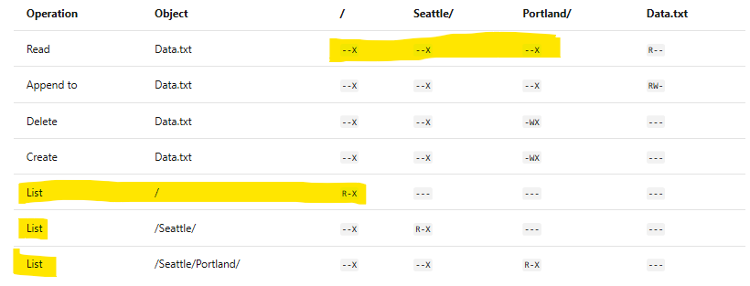
ADLS Gen 1 – ACL Basics

Slide 7
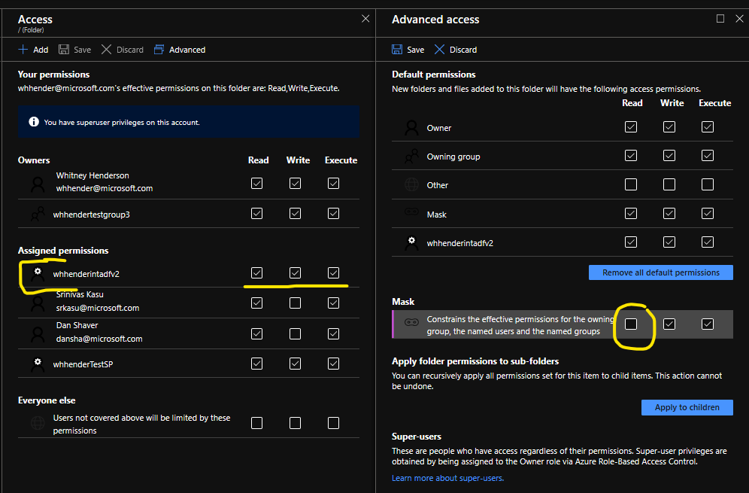
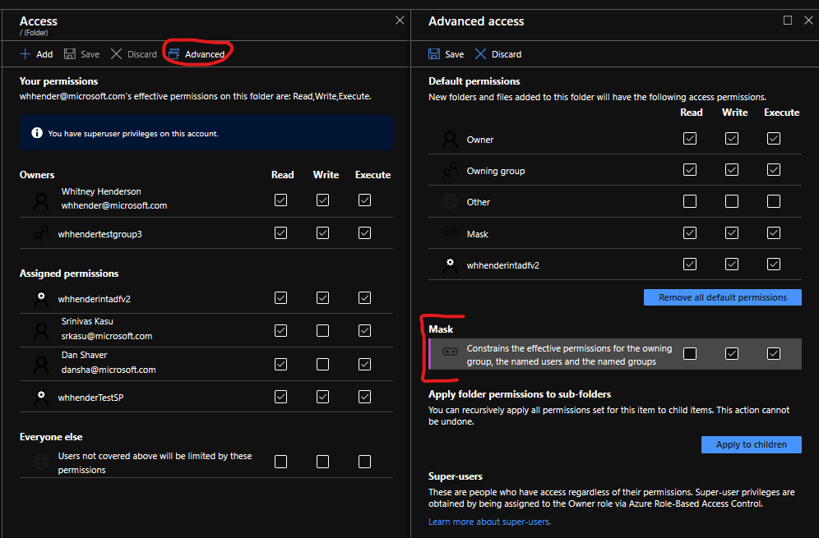
ADLS Gen 1 – The Mask / Effective Permissions

Slide 8
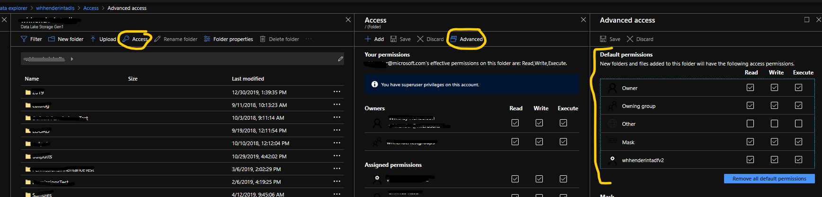
ADLS Gen 1 – Default Permissions and ACL Inheritance

Slide 9
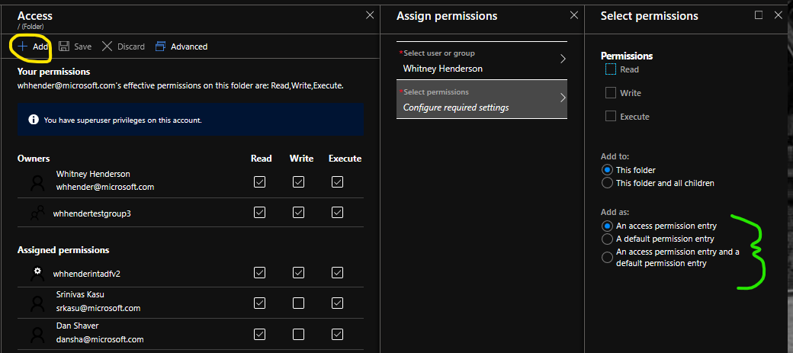
ADLS Gen 1 – Adding Permissions (Portal)

Slide 10
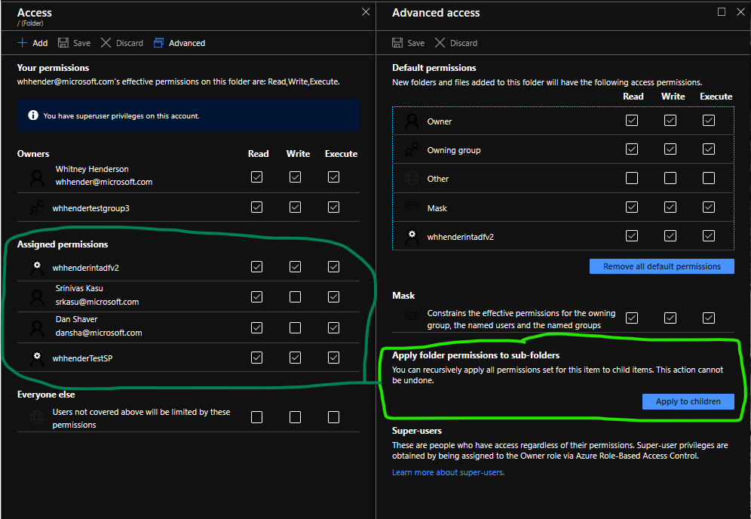
ADLS Gen 1 – Adding Permissions (Portal)

Slide 11
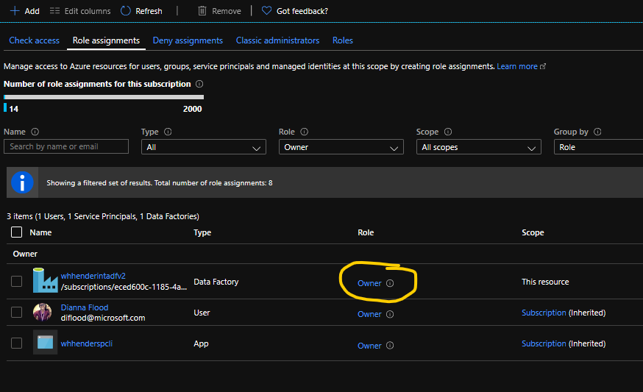
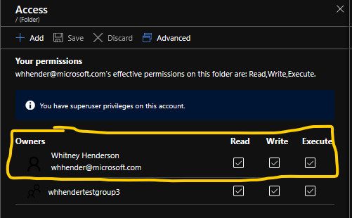
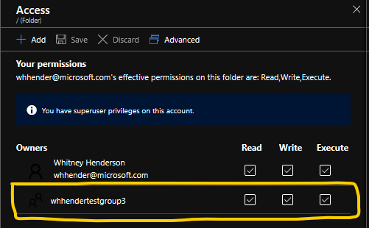
ADLS Gen 1 – Superusers vs Owning Users vs Owning Group
Super User
Owning User
Owning Group
- RBAC ‘Owner’
- All access to all files and folders.
- Able to change permissions on any files and folders.
- Able to edit owning user and owning group of any file/folder.
- First listed under ‘Owners’ on folder/file access.
- Indicated permission on this file/folder
- Able to change permissions on this file/folder
- Able to change owning group if they are in the new group.
- Second listed under ‘Owners’ on folder/file access
- Indicated permission on this file/folder
- UNABLE to change permissions on this file/folder.
- UNABLE to edit owning user and owning group of any file/folder.

Slide 12
ADLS Gen 1 – Permissions Limitations
Using the Portal to apply permissions
The portal must stay open for the duration of the operation.
Slower, more time consuming
Likely to fail/time out at scale.
Resolution: A scripting tool like the Azure CLI, PowerShell or the ADLS Tool: https://azure.github.io/data-lake-adlstool/doc/
2. Only 32 TOTAL Individual ACLs are allowed to be assigned to any file/folder. This includes owning group and Owning User.
Resolution: Assign individual ACL permissions to groups, then add uses to or remove users from those groups to manage access on the data lake.

Slide 13
ADLS Gen 1 – How to Troubleshoot Permissions
What is the error message, and what are they doing when they see it?
If no error message, what is the behavior they are seeing, and what is the behavior they expect to see?
What action does the user need to be able to perform?
What are the permissions on the file/folder in question?
What are the permissions on the parent folder structure? (Do they have –X?)
What is the mask setting for the file/folder in question?
What is the mask setting on the parent folder structure?
Tip: These questions can technically be answered in an email, but it is so much quicker to troubleshoot these issues in a screenshare. If your permissions troubleshooting goes beyond 1 or 2 emails, set up a meeting.
If the customer is running a script and seeing an ACL error message, but the user in question seems to have all necessary permissions, run a Jarvis query to make sure the user they expect is the user that is running the query!

Slide 14
ADLS Gen 1 – User-Deleted Resource
Important: We do not support restoration of user-deleted resource and therefore we cannot guarantee that we will be able to restore customer data lake, no matter when they report the issue. However, we will make a best effort.
If data lake was encrypted:
We CANNOT restore this data lake.
For ARR cases or other large customers, reach out to SME or TA before communicating this with Cx.
Information from Customer:
ADLS Resource Name
ADLS Resource Region
Approximate Timestamp of Deletion
Was the data lake encrypted?
If data lake was NOT encrypted:
We CAN make a best effort to restore this data lake. It is still not guaranteed, but we will work with the PG to do what we can.
Open an ICM with the Store team with the Cx info.

Slide 15
ADLS Gen 1 – User-Deleted Data
Important: We do not support restoration of user-deleted data and therefore we cannot guarantee that we will be able to restore customer data, no matter when they report the issue. However, we will make a best effort to restore their deleted data.
Information from Customer:
ADLS Resource Name
ADLS Resource Region
Files/Folder Path that Were Deleted
Approximate Timestamp of Deletion
Single Delete Operation, or Recursive?
Do we have permission to restore the data?
Should the data be restored to the original folder, or a restoration folder like <original folder Name>_restore?
Next Step:
Open a Sev-3 ICM to Azure Data Lake Store – Store Team with all information from Customer and CSS.
For ARR – Sev 2
Information from CSS:
Jarvis query link with all delete operations.
If issue was caused by single delete operation, also provide that Activity ID.

Slide 16
ADLS Gen 1 – Performance Troubleshooting
Timeouts - Connectivity Problems - Throughput
Gather Cx Information – Error messages, client-side logs showing performance trouble…
Gather Cx Expectation – What are they seeing, what do they expect?
When did this issue begin? Did they always see this problem?
Consider Cx scenario to evaluate for possible best practices.
Check TSGs
Evaluate Scenario in Jarvis – look for latencies, request size, request frequency.
Reach out to SME/TA, ADLS Teams Channel, Open ICM
ADLS Gen 1 Best Practices:
Fewer, larger files rather than many, small files.
Read large amounts of data in parallel.
Files created with many, tiny appends will eventually show performance problems. Re-Create these files, and in future, create files with fewer-larger appends.

Slide 17
ADLS Gen 1 – Jarvis Demo
There is a Jarvis for ADLS Gen 1 Guide on the big data wiki: aka.ms/bigdata
It covers everything we will see today and has a quick-reference and gotchas tips at the end.
Demo

Slide 18
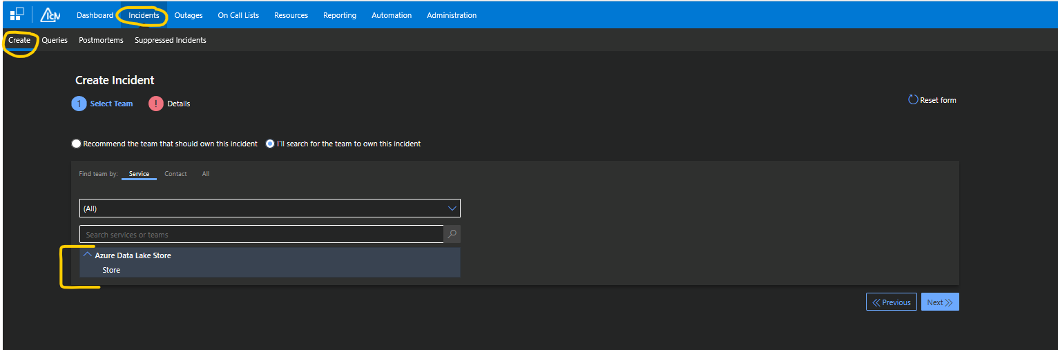

ADLS Gen 1 – ICM Demo

Slide 19
Resources, Meetings, References
Jarvis Link: https://jarvis-west.dc.ad.msft.net/logs/dgrep
Big Data Wiki: aka.ms/bigdata
Teams Channel: ADLS Gen1 – CSS Collaboration
Daily Meeting: ADLS/ADLA: Open ICM and VSTS Items
Create ICM: icm.ad.msft.net/ Then go to Incidents -> Create

